Slide 1

Using digital games in the language classroom
Frederick J. Poole
Doctoral Student
Instructional Technology and Learning Sciences
Notes:
Introduce self
PhD student at Utah State University, ITLS department researching games and language learning
Systematic review/exploring games and their utility in the L2 learning process
Feel free to offer suggestions/critiques

Slide 2
Four Parts/Goals for Today
Discuss what is a game and how should games be defined.
Present preliminary findings from systematic review on games.
Discuss principles for choosing games and integrating them into the foreign language classroom.
Provide example games with activity ideas.

Slide 3
What comes to mind when you hear game?
Notes:
Before we get into discussing what a game is…. Let’s look at why we play games…

Slide 4
Why do we use games in the language classroom?

Slide 5
Why use a game for language learning?
Games are enjoyable (at least that’s the idea)
Motivation
Highly contextualized learning environments
Interactive Learning Environments
Collaboration and meaningful interactions
Immediate (and sometimes personalized) feedback
Others?
Notes:
Interactive learning environments – sandbox games
Meaningful interactions – communication is needed to accomplish a goal
Feedback – loss of life, equipment points, or gain points, equipment, life, etc.
Keep these ideas in mind as we discuss what is a game.

Slide 6
What is a game?
Notes:
Competition – most skillful wins, and usually always wins
Role play – end/beginning, no chance for failure, no obstacle to overcome… if you wish to participate then you participate… if not then done….
Second Life, Minecraft --- simulations but can be games…

Slide 7
One more thing about games…
Notes:
Too much randomness --- and no skill…..
Games often have a story/narrative to immerse the player and to give them direction or a goal (e.g. save the princess).

Slide 8
Defining Games
Source | Game Definition
Salen, K. and Zimmerman, E. (2004) Rules of Play: Game Design Fundamentals. Cambridge:MIT Press. | ‘‘[a] game is a system in which players engage in an artificial conflict, defined by rules, that results in a quantifiable outcome.’’
Suits, B. (1978). Grasshopper: Games, Life and Utopia. Toronto, ON: University of Toronto Press. | "to play a game is to attempt to achieve a specific state of affairs, using only means permitted by rules, where the rules prohibit use of more efficient in favor of less efficient means, and where the rules are accepted to just because they make possible such activity. "
Schell, J. (2008). The Art of Game Design: A Book of Lenses. Morgan Kaufmann. | "a game is a problem solving activity, approached with a playful attitude"
Burgun, K. (2012). Game design theory: A new philosophy for understanding games. CRC Press. | "a system of rules in which agents compete by making ambiguous, endogenously meaningful decisions"

Slide 9
Why is it important that we define games?
Our definition of a game will shape how we feel about games and ultimately if we use games in the classroom.
Our definition of a game will also guide how we evaluate games and how we choose to use games.

Slide 10
Game Definition: My Two-Thirds Compromise
Can be won or lost (failure is possible)
Story/ Narrative/ Overarching goal
Balance of Skill and Randomness
Notes:
Won or lost is defined loosely in that you can get better or worse… you can die or you can survive…

Slide 11
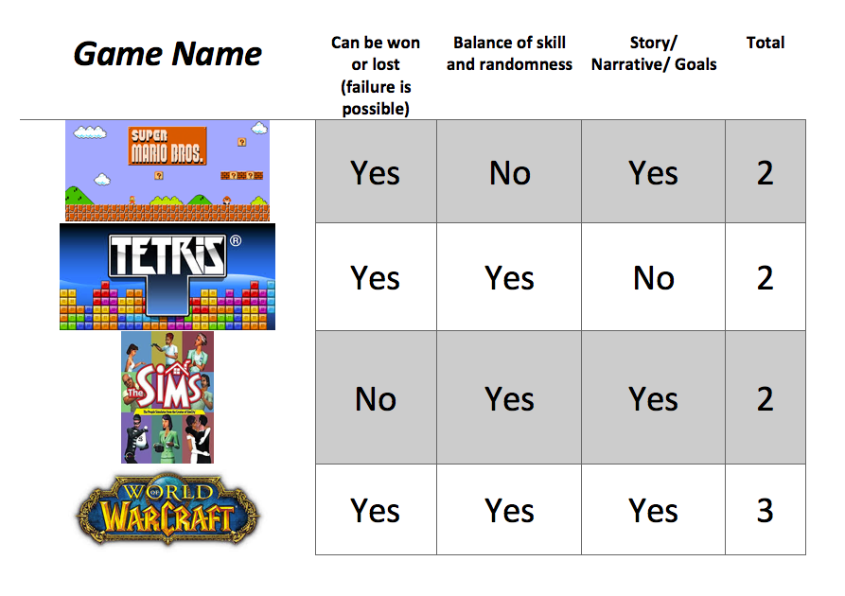
Applying the Definition

Slide 12
What has research done with games?
Notes:
Show how researchers/educators are thinking about games

Slide 13
Systematic Review
78 studies reviewed that conducted research on Second Language Learning using Digital Games
**DISCLAIMER– I have nothing against physical games.
Studies were coded by year, language, methodology, research focus, type of assessments, gaming environment, type of games used, game supports, platform, and whether or not the game was played individually or in a group.

Slide 14

Notes:
Not because people are realizing the value, but because creating games is become easier, we can mod games, we can collect data in games easier.

Slide 15
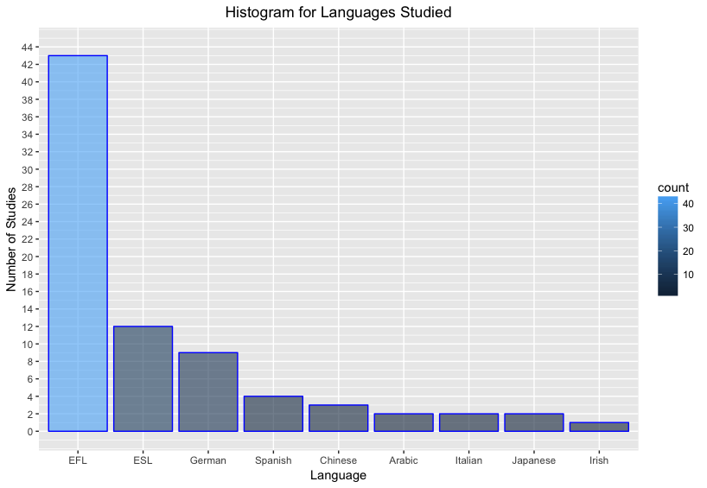
Notes:
Most games are in English… recently more and more games are being translated into other games.

Slide 16
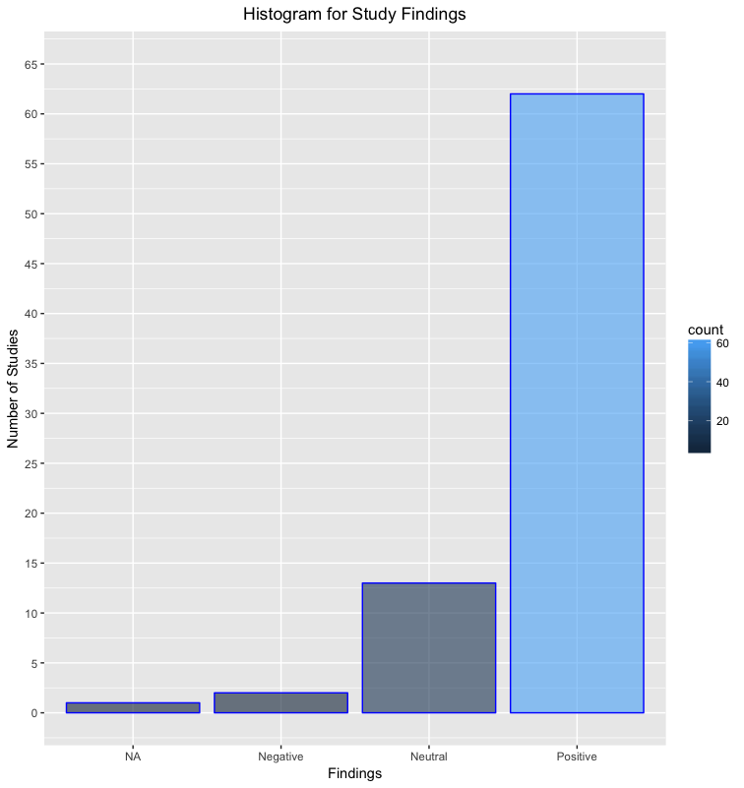
Notes:
Most studies surprise surprise have been positive…. Positive results get published
Two negative studies found that games can cause cognitive load overload….

Slide 17
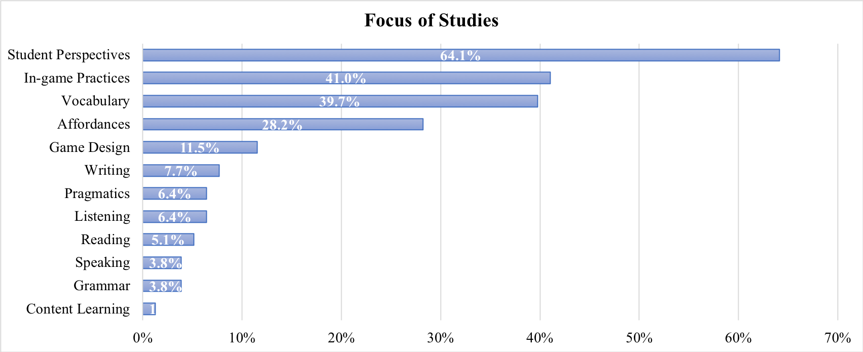

Slide 18
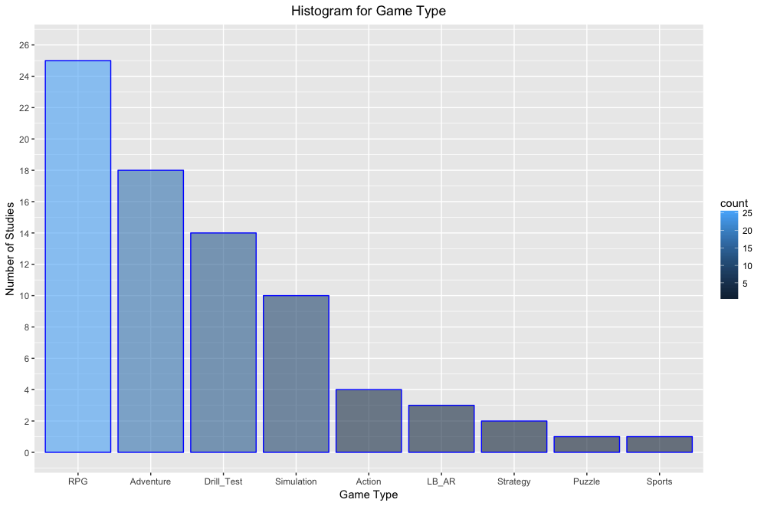
Notes:
Types of games used, primarily RPG and Adventure games… RPG and Adventure are probably the easiest to ‘get into’

Slide 19
Action
Platform games (e.g. Mario)
Shooter games (e.g. Half-Life)
Fighting games (e.g. Batman: Arkham City)
Stealth games (e.g. Shadow Tactics)
Survival Games (e.g. Left 4 Dead)
Rhythm Games (e.g. Parra the Rapper 2)
Adventure
Text Adventures (e.g. Banner Saga, Oregon Trail)
Graphic Adventures (e.g. Walking Dead – Tell Tale series)
Visual Novels
Real-Time 3D adventures
Point and Click
Role Playing Games (RPG)
Action RPG
MMORPG
Roguelikes
Tactical RPG
Sandbox RPG
Simulation
Construction Management (e.g. Farming Simulator, Sim City)
Life Simulation (e.g. Stardew Valley)
Vehicle simulation (e.g. Euro Truck Simulator 2)
Strategy
Real-Time Strategy (e.g. Command and Conquer, Age of Empries)
MOBA (e.g. DOTA 2)
Turn-Based Tactical – X-Com
Sports
Puzzle Games
(e.g. Portal, Myst, etc.)
Drill_Test
Location-Based/Augmented Reality

Slide 20
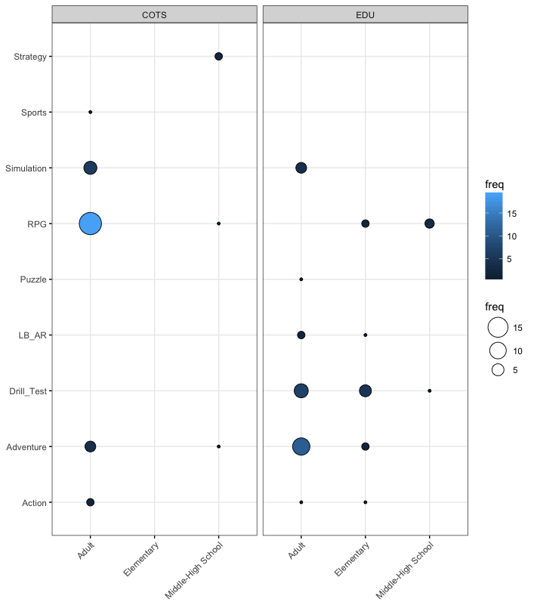
Notes:
COTS vs EDU
Elementary studies only use EDU
COTS primarily focused on RPG
Drill and test big in the EDU games

Slide 21
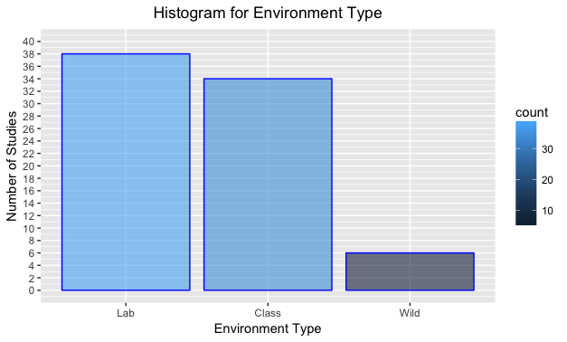
Notes:
Lab vs Class vs Wild

Slide 22
In-Class Studies
How the game was used | Description
Game Time | Play a game to make some aspect of language learning less dull.
Introduce a new Topic | Play the game to introduce a new in-class topic.
Review a Topic | Play the game to review a topic already discussed in class.
Facilitate Discussion | Game is used to mediate conversation (Information-Gap, Experience sharing, etc.).
Facilitate Writing | Game is used to inspire writing topics or to help understanding of a topic (Diary writing, narrative writing, argumentative writing).
Noticing | Game was used to draw attention to certain aspects of the language (typically used a Player-Watcher strategy).

Slide 23
Questions about the research?

Slide 24
Thinking about principles for choosing a game and integrating the game into the classroom.

Slide 25
Things to think about…
How do you envision using games in your classroom?
For Motivation? Context? Collaboration?
How does fun figure into your evaluation of a good game?
How do you evaluate whether a game is fun or not?
How important is the story/narrative when choosing a game?
Is the story relevant to your lesson? Age appropriate? Accurate?
What resources do you have at school for playing the game?
IPAD? PC? Phones?
What learning opportunities are associated with the game?
Collaboration? Enhanced noticing? Vocabulary? Content?
What is needed for learners to play the game?
Cheat sheet? Pre-lecture? Etc.

Slide 26
Discuss with a neighbor
Compare and contrast using a game for motivation, contextualization, and collaboration?
What aspects of language would you most likely be focusing on in each case?
Can you think of other reasons for using games in the classroom?

Slide 27
Discuss with a neighbor
Are all games fun?
Give an example of a fun game and a boring game. What is different between the games?
In your opinion what makes a game fun?
How does fun figure into your evaluation of a good game? Explain.

Slide 28
Discuss with a neighbor
How important is the story/narrative when choosing a game?
Can students learn from games without stories?
What types of things are they probably learning in games without a narrative?

Slide 29
Discuss with a neighbor
What is needed for learners to play the game?
Make a list of resources that students may need to play a game successfully.

Slide 30
Principles for Integrating Games into the Classroom
How do these steps change
in a multiplayer game?
Before Playing
Introduce the game
Give adequate training on game mechanics before playing
While Playing
Provide in-game support
Schedule stopping points to discuss gameplay strategies
Create mechanisms to promote noticing and recall
After Playing
Discussion/Writing activities that use in-game content
Compare and contrast in-game experiences/ notes
Make connections between in-class lectures and in-game material
Notes:
1. It takes time to master game mechanics

Slide 31
Other general guidelines…
Mastering game mechanics takes time…
You should be familiar with the game before you bring it into the classroom.
Use game log files to get an idea of the vocabulary

Slide 32
Example Games & Classroom Suggestions

Slide 33
Stardew Valley German, Spanish, Japanese, Portuguese, Russian, Sim. Chinese
Compare and contrast farms
Build an in-class resource center
Lesson on farming, community, mining, etc.
Writing daily routines
Comparing best routines
NPC bibliographies
Share Crafting Recipes
Other Ideas??
Notes:
Loop game
Players can farm, raise animals, fish, meet people in the community, mine for material, craft items, fight baddies, and complete quests to make the world a better place.
Game is moddable
Lots of languages

Slide 34
ECO Just English now, but other languages coming.
Lessons on animals, habitats, environment.
In-class discussion on strategies and roles
Share vocabulary and skills learned
Comparing how world changes.
Share crafting recipes
Other ideas??
Notes:
Much like minecraft except more life-like
Also there is a goal added to this… asteroid is going to blow up the world in 30 days… you have to develop civilization without destroying the world.
You also build things, craft items, learn skills… but you must collaborate to do it.

Slide 35
Terraria French, Italian, German, Spanish, Polish, Portuguese, Russian, Sim. Chinese
In-class discussion of survival strategies.
Plan, build, evaluate, repeat.
Diary of new words, compare diaries.
Compare and contrast worlds.
Share crafting recipes
Other ideas?
Notes:
This is a sandbox game in which players work together to build a home and survive… you collect materials, you explore, you craft items and progress through the game.

Slide 36
Sid Meier’s Civilization V French (A), German (A), Italian (A), Spanish (A), Polish, Japanese, Korean, Russian, Trad. Chinese
Compare reality to game
Compare civilizations
Lessons on in-game personas
In-class discussion of game strategies
Player-Watchers
Other ideas??
Notes:
This is a game in which you manage a certain civilization, (e.g. America, Arabia, Austria, China, Egypt)
You are exposed to different people, items, government/political concepts associated with the civilizations… great for teaching history

Slide 37
We were here too 10+ Languages
Dyads compare strategies and experiences.
Writing recall activity.
Class discussion on unknown vocabulary/phrases.
Other ideas?
Notes:
Older/more mature learners … it’s a little scary…

Slide 38
The Banner Saga 10+ languages
Compare story outcomes
NPC biographies
Compare Viking realities to in-game stories
Other ideas?
Notes:
Viking mythology and tradition
Take control of different NPCs
Choices matter
Everyone has a different story
Mix between reading and battles
Single player

Slide 39
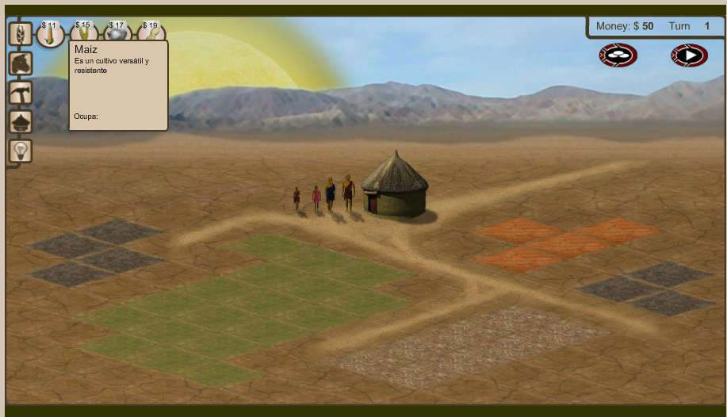
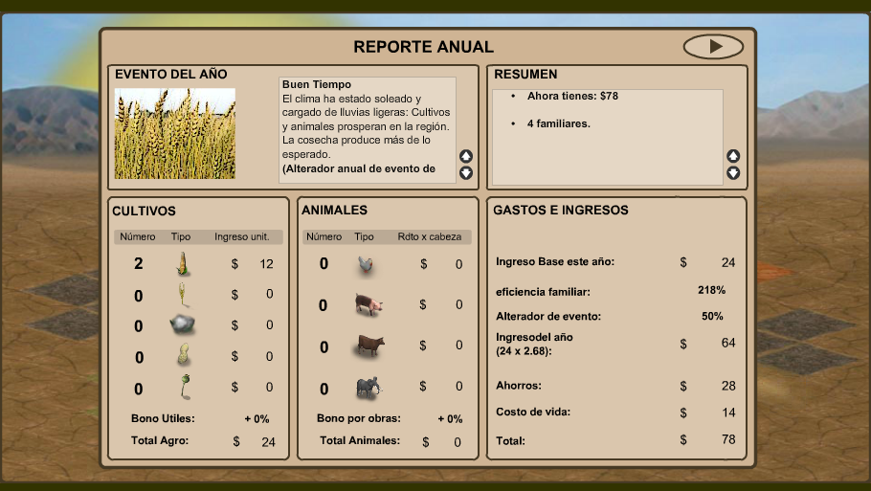
3rd World Farmer Spanish, French, Italian, German, Portuguese
Compare random events
Pre-teach farming vocabulary
Discuss strategies and outcomes
Compare and contrast farms
Other ideas??
https://3rdworldfarmer.org/
Notes:
Free
Build a farm … learn vocabulary on farming materials and tools also learn vocabulary from random world events.

Slide 40
Age of Conquest IV 24 + Languages
In-class discussion of strategies
In-class negotiations for collaborations and alliances
Lessons on country management
In-class map replicas
Other ideas??
Notes:
Like a simpler version of Civilization. Build an empir.re and expand… this is cool because it has local co-op or local multiplay

Slide 41
FREE MMORPGs
Guild Wars 2 -
Spiral Knights – French, German, Spanish
Path of Exile –Portuguese, Russian, Thai, French, German, Spanish
RPG MO- 14 languages
Trove – French, German, Portuguese
Notes:
1. Create Groups/guilds
2. Turn off public chat
3. Designate certain quests for hwk assignments
4. Report to class adventures.

Slide 42
Questions / Thoughts?
If you are interested in integrating games into your curriculum and/or you would like help integrating games into your curriculum please feel free to contact me at frdbrick@gmail.com

